Slide 1
Chapter 10 Multiprocessor and Real-Time Scheduling
Notes:
1

Slide 2
Classifications of Multiprocessors
Multiprocessors
Loosely coupled multiprocessor.
each processor has its own memory and I/O channels
Functionally specialized processors.
such as I/O processor
controlled by a master processor
Tightly coupled multiprocessing.
processors share main memory
controlled by operating system
Notes:
2

Slide 3
Synchronization Granularity
Multiprocessors
Grain Size | Description | Uses | Synchronization Interval (Instructions)
Fine | Parallelism inherent in a single instruction stream | ? | < 20
Medium | Parallel processing or multitasking within a single application | Threads w/in application | 20 to 200
Coarse | Multiprocessing of concurrent processes in a multiprogramming environment | Unix pipes | 200 to 2000
Very Coarse | Distributed processing across network nodes to form a single computing environment | Make File applications | 2000 to 1M
Independent | Multiple unrelated processes | Time-sharing | (N/A)
Notes:
3

Slide 4
Independent Parallelism
Parallelism
Separate processes running.
No synchronization.
An example is time sharing.
average response time to users is less
more cost-effective than a distributed system
P₀
P₁
P₂
P₃
Memory

Slide 5
Very Coarse Parallelism
Parallelism
Distributed processing across network nodes to form a single computing environment.
In general, any collection of concurrent processes that need to communicate or synchronize can benefit from a multiprocessor architecture.
good when there is infrequent interaction
network overhead slows down communications
Network
P₀
P₁
P₂
P₃
Memory
Memory
Memory
Memory

Slide 6
Coarse Parallelism
Parallelism
Similar to running many processes on one processor except it is spread to more processors.
true concurrency
synchronization
Multiprocessing.
P₀
P₁
P₂
P₃
Memory

Slide 7
Medium Parallelism
Parallelism
Parallel processing or multitasking within a single application.
Single application is a collection of threads.
Threads usually interact frequently.
P₀
P₁
P₂
P₃
Memory

Slide 8
Fine-Grained Parallelism
Parallelism
Much more complex use of parallelism than is found in the use of threads.
Very specialized and fragmented approaches.
P₀
P₁
P₂
P₃
Memory

Slide 9
Assigning Processors
Scheduling
How are processes/threads assigned to processors?
Static assignment.
Advantages
Dedicated short-term queue for each processor.
Less overhead in scheduling.
Allows for group or gang scheduling.
Process remains with processor from activation until completion.
Disadvantages
One or more processors can be idle.
One or more processors could be backlogged.
Difficult to load balance.
Context transfers costly.
Notes:
9

Slide 10
Assigning Processors
Scheduling
Who handles the assignment?
Master/Slave
Single processor handles O.S. functions.
One processor responsible for scheduling jobs.
Tends to become a bottleneck.
Failure of master brings system down.
Peer
O.S. can run on any processor.
More complicated operating system.
Generally use simple schemes.
Overhead is a greater problem
Threads add additional concerns
CPU utilization is not always the primary factor.
Notes:
10

Slide 11
Process Scheduling
Scheduling
Single queue for all processes.
Multiple queues are used for priorities.
All queues feed to the common pool of processors.
Specific scheduling disciplines is less important with more than one processor.
Simple FCFS discipline or FCFS within a static priority scheme may suffice for a multiple-processor system.
Notes:
11

Slide 12
Thread Scheduling
Scheduling
Executes separate from the rest of the process.
An application can be a set of threads that cooperate and execute concurrently in the same address space.
Threads running on separate processors yields a dramatic gain in performance.
However, applications requiring significant interaction among threads may have significant performance impact w/multi-processing.
Notes:
12

Slide 13
Multiprocessor Thread Scheduling
Scheduling
Load sharing
processes are not assigned to a particular processor
Gang scheduling
a set of related threads is scheduled to run on a set of processors at the same time
Dedicated processor assignment
threads are assigned to a specific processor
Dynamic scheduling
number of threads can be altered during course of execution
Notes:
13

Slide 14
Load Sharing
Scheduling
Load is distributed evenly across the processors.
Select threads from a global queue.
Avoids idle processors.
No centralized scheduler required.
Uses global queues.
Widely used.
FCFS
Smallest number of threads first
Preemptive smallest number of threads first
Notes:
14

Slide 15
Disadvantages of Load Sharing
Scheduling
Central queue needs mutual exclusion.
may be a bottleneck when more than one processor looks for work at the same time
Preemptive threads are unlikely to resume execution on the same processor.
cache use is less efficient
If all threads are in the global queue, all threads of a program will not gain access to the processors at the same time.
Notes:
15

Slide 16
Gang Scheduling
Scheduling
Schedule related threads on processors to run at the same time.
Useful for applications where performance severely degrades when any part of the application is not running.
Threads often need to synchronize with each other.
Interacting threads are more likely to be running and ready to interact.
Less overhead since we schedule multiple processors at once.
Have to allocate processors.
Notes:
16

Slide 17
Dedicated Processor Assignment
Scheduling
When application is scheduled, its threads are assigned to a processor.
Advantage:
Avoids process switching
Disadvantage:
Some processors may be idle
Works best when the number of threads equals the number of processors.
Notes:
17

Slide 18
Dynamic Scheduling
Scheduling
Number of threads in a process are altered dynamically by the application.
Operating system adjusts the load to improve use.
assign idle processors
new arrivals may be assigned to a processor that is used by a job currently using more than one processor
hold request until processor is available
new arrivals will be given a processor before existing running applications
Notes:
18

Slide 19
Real-Time Scheduling

Slide 20

Real-Time Systems
Real-Time
Correctness of the system depends not only on the logical result of the computation but also on the time at which the results are produced.
Tasks or processes attempt to control or react to events that take place in the outside world.
These events occur in “real time” and process must be able to keep up with them.
Require results be produced before specified deadlines.
Notes:
20

Slide 21
Real-Time Systems
Real-Time
Very common in embedded systems – a computing device whose presence is not obvious
Hard real-time: missed deadlines result in damage or death
safety-critical systems
Soft real-time: missed deadlines may result in lower performance, but can be tolerated
most real-time systems are soft real-time
Examples: Hard or Soft?
Pacemaker
Dishwasher / Furnace
Process control plants
Fax machine
Robotics
Camera / MP3 player
Router / Switch
Air traffic control
Cell phone
Wristwatch
Telecommunications
Laboratory experiments
Radiation treatment
Airplane
Automobile
Notes:
21

Slide 22
Characteristics of Real-Time OS
Real-Time
Deterministic
Operations are performed at fixed, predetermined times or within predetermined time intervals.
Responsive – Minimal Latency
Interrupt latency – time from the arrival of an interrupt at the CPU to the start of the interrupt service routine.
Dispatch latency – time required for the scheduling dispatcher to stop one process and start another.
Preemptive kernel.
User control
Single purpose, economical – system-on-chip (SOC)
Configurable – paging, residency, rights
Notes:
22

Slide 23
Characteristics
Real-Time
Reliable
Degradation of performance may have catastrophic consequences.
Preemptive, priority-based scheduling - most critical, high priority tasks execute
Fail-Soft Operation
Ability to handle system failures by gently reducing performance
If a shutdown can’t be avoided, then try to do so gracefully (Example: Fighter flight-control system that adjusts for damage to the system.)
Stability - ability to meet the most important deadlines even if lower priority deadlines cannot be met.
Notes:
23

Slide 24
Features of RTOS
Real-Time
Fast context switch – preemptive kernel
Small size/minimal functionality (small footprint)
Ability to respond to external interrupts quickly
Multitasking with interprocess communication tools such as semaphores, signals, and events
Files that accumulate data at a fast rate
Preemptive scheduling with priority
Minimize time with interrupts off
Primitives to delay tasks for a fixed amount of time, pause/resume tasks
Special alarms and timeouts
Notes:
24

Slide 25
Real-Time Scheduling
Real-Time Scheduling
Static table-driven
Schedule periodic tasks in advance
Changes result in redoing schedule
Static priority-driven preemptive
Takes advantage or priority-based scheduler
Give higher priorities to real-time tasks
Based on time constraints, importance
Dynamic planning-based
Try to revise schedule when a task arrives
Dynamic best effort
Assign priorities based on the task, such as earliest deadline
Used by many real-time systems
Easy to implement
Hard to know if a deadline will be met
Notes:
25

Slide 26
Deadline Scheduling
Earliest-Deadline-First
Real-time applications are not concerned with speed but with completing tasks
Scheduling tasks with the earliest deadline minimizes the fraction of tasks that miss their deadlines
Includes new tasks and amount of time needed for existing tasks
Notes:
26

Slide 27
Two Periodic Tasks
Earliest-Deadline-First
Execution profile of two periodic tasks
Process A
Arrives 0 20 40 …
Execution Time 10 10 10 …
End by 20 40 60 …
Process B
Arrives 0 50 100 …
Execution Time 25 25 25 …
End by 50 100 150 …
Question: Is there enough time for the execution of two periodic tasks?
Notes:
27

Slide 28
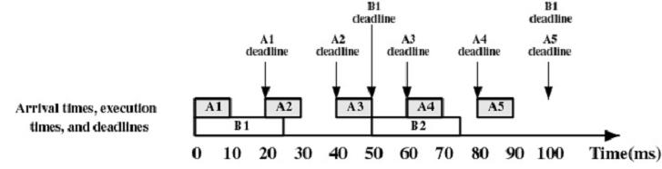
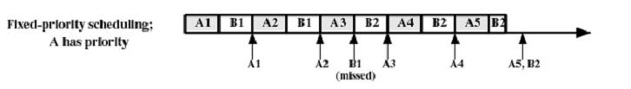
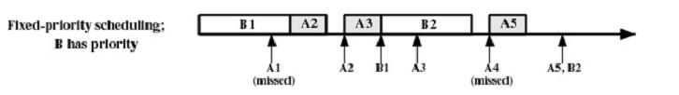
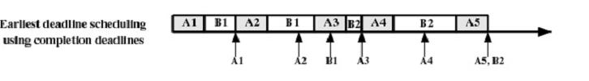
Earliest-Deadline-First
Scheduling 2 Periodic Tasks

Slide 29
Five Periodic Tasks
Earliest-Deadline-First
Execution profile of five periodic tasks
Process | Arrival Time | Execution Time | Starting Deadline
A | 10 | 20 | 110
B | 20 | 20 | 20
C | 40 | 20 | 50
D | 50 | 20 | 90
E | 60 | 20 | 70
Question: Is there enough time for the execution of five periodic tasks?
Notes:
29

Slide 30
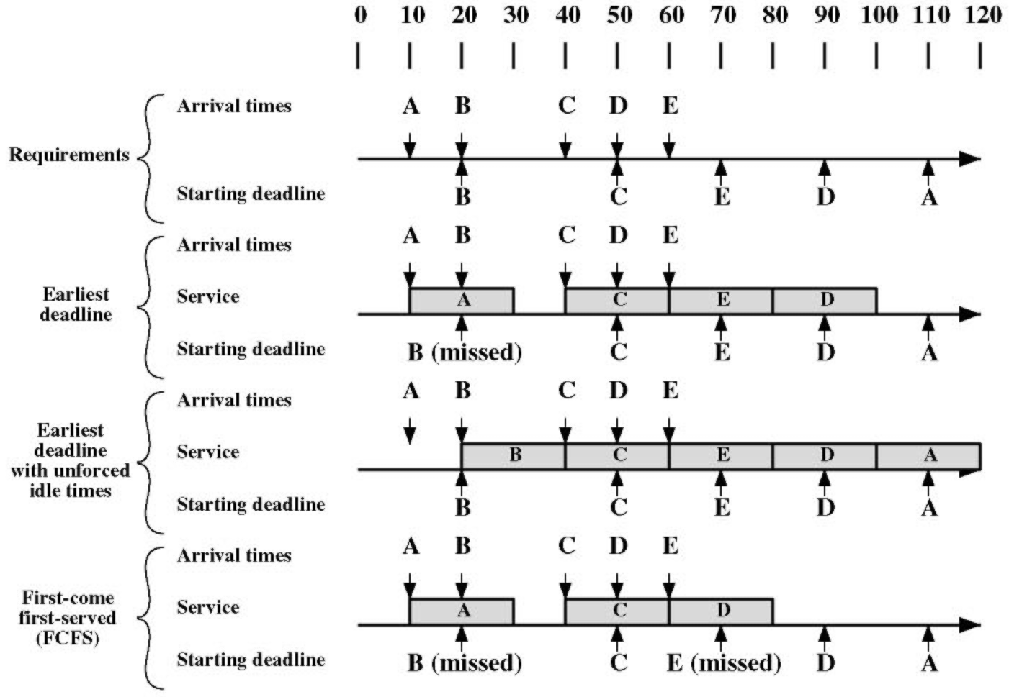
Scheduling of Real-Time Tasks
Earliest-Deadline-First
Notes:
30

Slide 31
Rate Monotonic Scheduling
RMS
The RMS algorithm schedules periodic tasks using a static priority policy with preemption.
Upon entering the system, each periodic task is assigned a priority inversely based on its period: the shorter the period, the higher the priority.
Gives higher priority to tasks that require the CPU more often
Assumes processing time of a periodic process is always the same
RMS guarantees, for a set of n periodic tasks with unique periods, a feasible schedule that will always meet deadlines exists if the CPU utilization is below a specific bound (depending on the number of tasks).
Despite being optimal, RMS has a limitation - CPU utilization is bounded and it is not always possible to fully maximize CPU resources.
Notes:
31

Slide 32
Rate Monotonic Scheduling
RMS
A simple version of rate-monotonic analysis assumes that threads have the following properties:
No resource sharing (processes do not share resources, e.g. a hardware resource, a queue, or any kind of semaphore blocking or non-blocking (busy-waits))
Deterministic deadlines are exactly equal to periods
Static priorities (the task with the highest static priority that is runable immediately preempts all other tasks)
Static priorities assigned according to the rate monotonic conventions (tasks with shorter periods/deadlines are given higher priorities)
Context switch times and other thread operations are free and have no impact on the model
Notes:
32

Slide 33
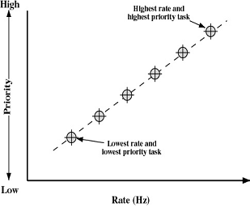
Rate Monotonic Scheduling
RMS
Parameters
P_{i} = Time between arrivals of the task (period)
T_{i} = Time required to do calculation
U_{i} = CPU Utilization = T_{i} / P_{i} (55 ms / 80 ms = 0.6875)
Give shortest-period task the highest priority
If Σ T_{i}/P_{i} ≤ n(2^{1/n} - 1), all n tasks can be successfully scheduled
n(2^{1/n} - 1) → 0.693 as n → ∞
This formula is conservative (90% utilization
can be done in practice)
This formula also holds for earliest deadline
scheduling
RMS generally used over Deadline
Performance difference small
Handles soft real-time parts better
Stability is easier to achieve
Notes:
33
One process = 100% CPU Utilization
2 = 83%
So, if there is 90% utilization of 2 tasks, then RMS cannot guarantee to meet deadlines.

Slide 34
Priority Inversion
CS 345
Homework #4
34
In many practical applications, resources are shared and the unmodified RMS will be subject to priority inversion and deadlock hazards.
In scheduling, priority inversion is the scenario where a low priority task holds a shared resource that is required by a high priority task.
This causes the execution of the high priority task to be blocked until the low priority task has released the resource, effectively "inverting" the relative priorities of the two tasks.
If some other medium priority task, that does not depend on the shared resource, attempts to run in the interim, it will take precedence over both the low priority task and the high priority task.

Slide 35
Mars Pathfinder
CS 345
Homework #4
35
Martian landing on July 4th, 1997
Periodically experienced total system resets.
VxWorks uses preemptive priority scheduling.
Access to “information bus” synchronized with mutexes.
Meteorological data gathering – low priority
Communication task – medium priority
Information bus manager – high priority
Data gathering held mutex, bus manager was blocked, communication task running, watchdog timer reset.

Slide 36
Priority Inversion Solutions
Disabling all interrupts to protect critical sections
Only two priorities: preemptible, and interrupts disabled, with no third priority - inversion is impossible. Since there's only one piece of lock data (the interrupt-enable bit), misordering locking is impossible, and so deadlocks cannot occur. Since the critical regions always run to completion, deadlock does not occur.
Priority inheritance
When priority is inherited, the low priority task inherits the priority of the high priority task, thus stopping a medium priority task from pre-empting the high priority task.
A priority ceiling
With priority ceilings, the shared mutex process (that runs the operating system code) has a characteristic (high) priority of its own, which is assigned to the task locking the mutex. This works well, provided the other high priority task(s) that try to access the mutex does not have a priority higher than the ceiling priority.
CS 345
Homework #4
36

Slide 37
VxWorks, Linux, Unix, Windows…

Slide 38
VxWorks
embedded real-time application
Wind River Systems
Hard real-time support
automobiles
industrial devices
networking
Spirit and Opportunity
Wind micro-kernel
tasks – execute in kernel mode
preemptive and nonpreemptive RR w/256 priority levels
bounded interrupt latency
shared memory / pipes
graphics library
virtual memory
VxVMI
file systems
Java library
POSIX library
TCP/IP
Wind micro-kernel
hardware level
(Pentium, Power PC, MIPS, customized, etc.)

Slide 39
Linux Scheduling
Linux Scheduling
Standard kernel code non-preemptible
Timer interrupts during kernel code sets a flag need_resched that causes rescheduling at the end of the kernel call
Only need to avoid accessing user memory and disable interrupts during critical data structure operations
Interrupt Service routines
Top Half – Runs with equal or lower-priority interrupts disabled
Bottom Half – Allow all interrupts
Scheduler ensures a bottom half doesn’t interrupt itself
Kernel can disable selected bottom halves during critical sections

Slide 40
Linux Priorities
Linux Scheduling
Based on scheduling credits
Select process with highest number of credits
Loses one credit for each timer interrupt
Suspended when no credits remaining
If no runnable processes have credits, assign new credits to all processes:
Credits = Credits/2 + priority
Multiprocessor Scheduling
First supported in 2.0.x kernel
Finer locking, threaded subsystems in 2.3.x kernel
Scheduler gives “bonus” if a thread is rescheduled on the same CPU

Slide 41
Linux Scheduler
Linux Scheduling
Three scheduling classes
SCHED_FIFO: FIFO real-time
Not interrupted unless:
Higher priority FIFO thread is ready
Tread blocks (such as I/O)
Thread voluntarily yields CPU
If interrupted, put in a queue
If it is ready and has higher priority, the other thread is preempted
SCHED_RR: round-robin real-time
Like FIFO, but with a time quantum
At the end of the quantum, another equal or higher-priority thread is scheduled
SCHED_OTHER: non-real-time
Only run when no real-time thread is ready

Slide 42
Real-time Linux
Real-time Linux Scheduling
Release 2.6
fully preemptive kernel
more efficient scheduling algorithm runs in O(1) regardless of number of tasks in system
kernel divided into modular components for easier porting
RTLinux
standard Linux kernel runs as a task
real-time kernel handles all interrupts
prevents standard Linux kernel from ever disabling interrupts
includes rate-monotonic and earliest-deadline-first

Slide 43
UNIX Scheduling
UNIX Scheduling
Set of 160 priority levels divided into three priority classes
Basic kernel is not preemptive
Priority
Class
Global
Value
Scheduling
Sequence
159
.
first
.
Real-time
.
.
100
99
Kernel
.
.
60
59
.
.
Time-shared
.
.
0
last

Slide 44
Unix SVR4 Scheduling
UNIX Scheduling
Two major modifications:
Addition of a preemptible static priority scheduler with three priority ranges
Real-time (159 - 100)
Kernel (99 - 60)
User time-share (59 - 0)
Insertion of preemption points into the kernel
Allow the kernel to be interrupted at specified safe locations
All resources are either not in use or locked via semaphore
Combination allows real-time processes to run before the kernel, and preempt the kernel when necessary

Slide 45
Win2000 Priorities
Windows Scheduling
Priority-driven preemptive scheduler
32 total priority levels
Real-time processes use levels 31-16
Other processes use levels 15-0
Round-robin within each priority level
Process base priority
Thread base priority – Offset from the
process base priority (max +/- 2)
Thread dynamic priority
Varies from process base priority
Raised when the thread blocks
Lowered when it uses its time quantum
Multiprocessor scheduling
N-1 highest-priority threads active
Other threads share the remaining processor
15
14
13
12
11
10
9
8
7
highest
6
above normal
5
base priority
normal
4
below normal
3
lowest
2
1
0
Process
Priority
Thread’s Base
Priority
Thread’s Dynamic
Priority

Slide 46
Embedded Systems
9 billion processors manufactured in 2005
2% used in new PCs, Macs, and Unix workstations
8.8 billion used in embedded systems
Special-purpose computer systems designed
to perform one or a few dedicated functions
with real-time computing constraints
Virtually every electronic device designed and manufactured today is an embedded system
Digital watches, MP3 players, traffic lights, factory controllers, peripherals, toys, microwaves, dishwashers, thermostats, greeting cards, gas meter, smart batteries, EKG, weight scales, smoke detectors, irrigation systems, …

Slide 47
Typical Applications
Handheld Measurement
Air Flow measurement
Alcohol meter
Barometer
Data loggers
Emission/Gas analyser
Humidity measurement
Temperature measurement
Weight scales
Medical Instruments
Blood pressure meter
Blood sugar meter
Breath measurement
EKG system
Utility Metering
Gas Meter
Water Meter
Heat Volume Counter
Heat Cost Allocation
Electricity Meter
Meter reading system (RF)
Sports equipment
Altimeter
Bike computer
Diving watches
Security
Glass break sensors
Door control
Smoke/fire/gas detectors
Home environment
Air conditioning
Control unit
Thermostat
Boiler control
Shutter control
Irrigation system
White goods (Washing machine,..)
Misc
Smart card reader
Taxi meter
Smart Batteries

Slide 48
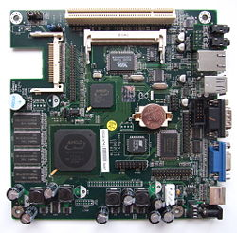
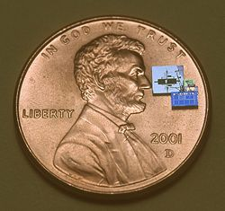
Embedded Systems
Benefits of embedded systems
Reduced size
Cost – mass produced
Reliability – expected to run for years
Performance – real-time events
Portability – low-power
Early systems
Apollo guidance computer, 1960
Minuteman missile, 1961
Intel 4004
Flash/RAM

Slide 49
Embedded Systems
User interfaces
Buttons
LEDs
Touch sensors
Joysticks
GPIO
Sensors
D/A, A/D
Universal Serial Communication Interface
UART
SPI
I²C

Slide 50
Embedded Systems
CPU platforms
Von Neumann / Harvard
RISC, CISC, VLIW
65x, 68x, 8051, PIC, ARM, Blackfin, Coldfire, eZ8x, MSP430, PowerPC, x86, Z80,…
System on a chip (SOC)
Application-specific integrated circuit (ASIC)
Field-programmable gate array (FPGA)
Single board computers (SBC’s)

Slide 51
Embedded Systems
Peripherals
Serial communication interfaces (SCI): RS-232, RS-485, …
Synchronous Serial Communication Interface: I²C, SPI, …
Universal Serial Bus (USB)
Networks: Ethernet, Controller Area Network, …
Timers: PLL’s, Capture/Compare, TPU’s, …
General Purpose Input/Output (GPIO)
Analog to Digital / Digital to Analog (ADC/DAC)
Debugging: JTAG, ISP, SPI-Wire, BDM Port…
Tools
Compilers, assemblers, debuggers
In-circuit debuggers, emulators

Slide 52
Embedded Systems
Architectures
Simple control loop
Interrupt controlled system (event driven)
Cooperative multitasking
Preemptive multitasking
Synchronization
Message queues
Semaphores
Non-blocking synchronization
Real-time OS
Microkernels / exokernels
Monolithic kernels: Embedded Linux, Windows CE

Slide 53
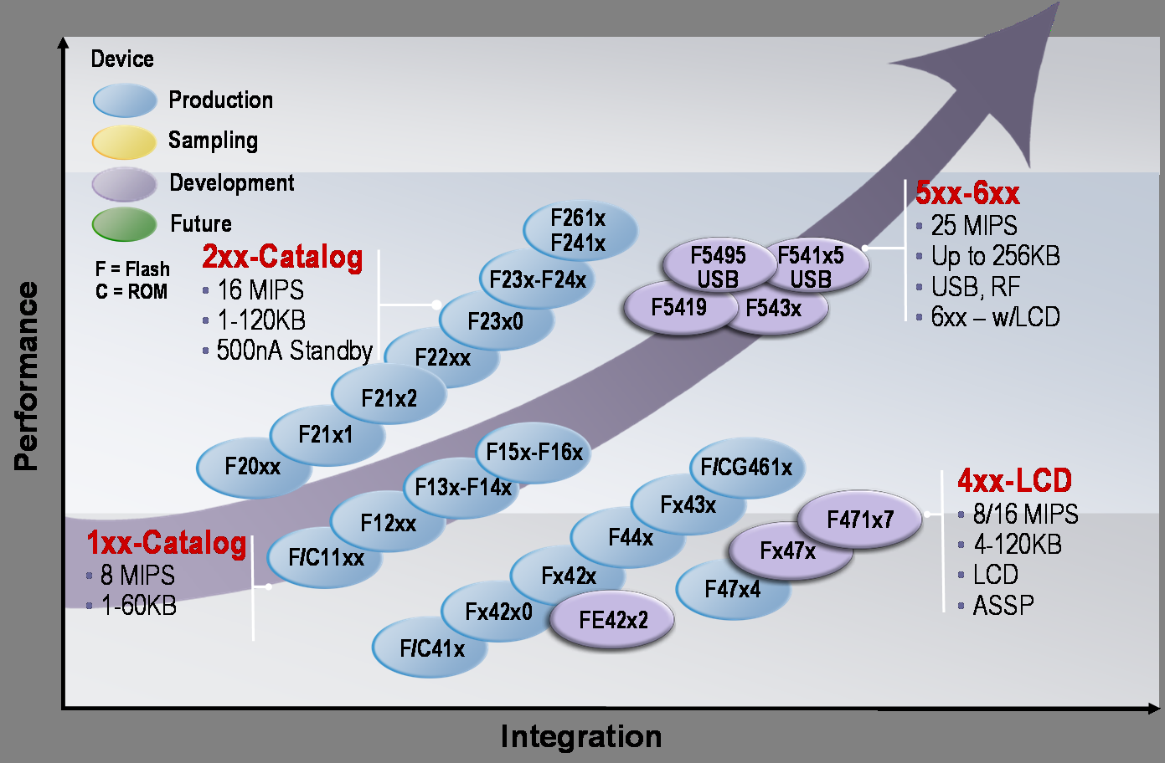
MSP430 Roadmap

Slide 54
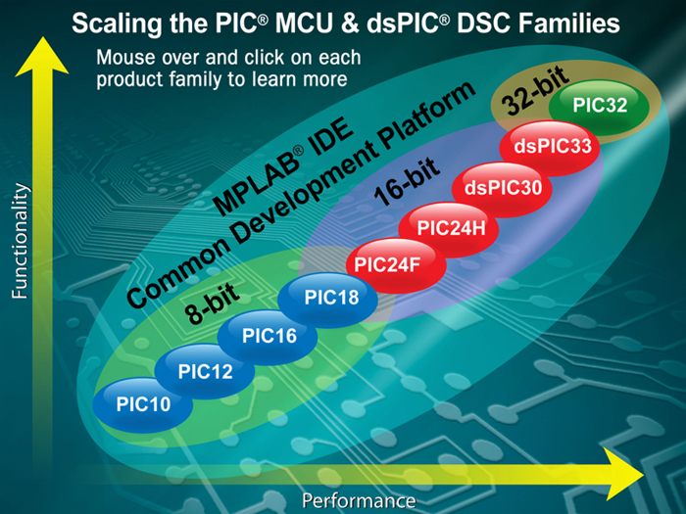
PIC Roadmap

Slide 55
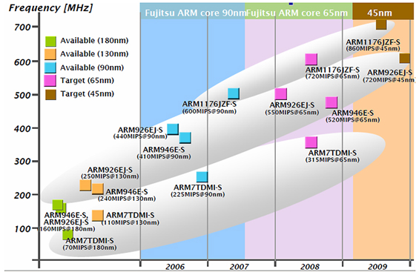
ARM Roadmap

Slide 56

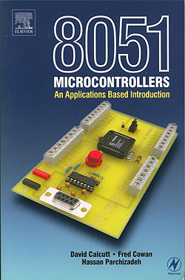


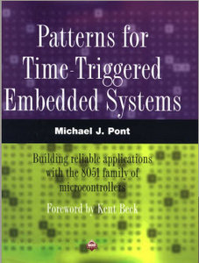

8051 Roadmap

Slide 57
Lots of RTOS’s
BRM | LABS/7 | RMX-80, RMX-86 | RTTS
BLMX | MERT | RPS | RTUX
BSO/RTOS | MINI-EXEC | RSX-11 | RTX
C Executive | MIRAGE | RSX-15 | RTX-16
CCP | MOSS | RTE-I, RTE-II, RTE-III, RTE-IV | RTX-16
CTOS | MROS-68K | RTE-6/VM | Rx
CTRON | MSP/7 | RTE-A | SAX
DES RT | MSP | RTEX | SIGMA 7 OS
DMERT | MTK-II | RTMOS | SPHERE
DSOS | OS/32-ST and OS/32-MT | RTM8 | STARPLEX II
E4 | OS/700 | RTMS | TRON
EDX | OS/RT | RTOS | USX
EIS-110 | p | RTOS | VAXELN
Executive II | PDOS | RTOS | VORTEX
FADOS | PORTX | RTOS | VRTX
GEM | pSOS | RTOS-16
iRMX | Reduced Core Monitor | RTOS/360
ITRON | RMS09, RMS68K | RTR

